Slide 1
Recitation 5
In this recitation you will have an example on displaying multiple objects on ObjectEditor. The code can be found in the recitation page.
To display multiple objects of different types, the basic idea is to have a big class, in which those objects are properties.
Notice you need to remove invalid ObjectEditor(properties—java build path -- Libraries), and import ObjectEditor again.

Slide 2
AUniverse
Class AUniverse is the class that contains all other objects.
To ensure that ObjectEditor can “see” these objects in Auniverse, every object needs to have getter method.
The line object theLine and point object lineLocation: theLine takes lineLocation as its X and Y. As a result, every time you set a new value for lineLocation, theLine will also move.

Slide 3
AStringShape and AShapeImage
AStringShape and AShapeImage are objects that displays a string text and an image respectively.
Both of them have a string property, which represents the string text or the filename of the image. And these two properties need to be initialized before it can be displayed on ObjectEditor.
For AShapeImage, in order to let the ObjectEditorthe can find the image file, the image file has to be in the project folder.

Slide 4
Tasks
Modify the constructor of Auniverse, use some different values to initialize these objects.
Find some new images and try to display them. i.e. set the string property of AShapeImage to the name of the image files (.jpg file )
Try new text in AStringShape
Notice that the AShapeImage class has properties height and width(it actually does not need them to work properly), try to set these two values smaller than the size of the image (or greater than), see what happens.
Use annotation @Visible(false), put them before the getter method

Slide 5
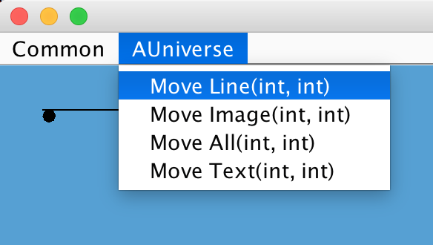
Use the tree view and debug mode to observe the logical structure and physical structure (you may need to set breakpoints to use the debug mode)
When ObjectEditor is running, notice the menu bar, under the list AUniverse, you can
see a list of methods. They are
actually public methods in
Auniverse except setters and
getters. Try to use these methods
to control these objects. You will need to use menu
in next assignment.

Slide 6
To Submit
Submit on Sakai a screenshot of something you composed with ObjectEditor (e.g. a house, stick figure with image for face, etc..)
You can use some of these shapes available to you:
Line
Point
Image (download from Internet to your project folder)
Text
Rectangle
Oval
Get your masterpiece to move using the moveAll() method as in the code we gave you.

